Slide 1
Prediction Of Extremism On Social Platforms
Presented by:-
1.Aman Garg (2000681530007)
2.Satyam (2000681530042)
3.Shiva Chauhan (2000681530043)
Under the supervision of :-
Dr. Anand Sharma (Faculty/Project Coordinator,
MIET Meerut)
Department of Artificial Intelligence & Machine Learning
Meerut Institute of Engineering & Technology, Meerut (U.P.)

Slide 2
Table Of Contents
Data Extraction
Methodology
Maintaining Diversity
Challenges
Data Labeling
Methodology
Maintaining Consistency
Challenges
Conclusion

Slide 3
Data Extraction

Slide 4
Methodology
After considering all the social media public platforms we decided to extract the data from twitter as it provides the most quality data for sequence classification task.
Methods we use to extract the data :
Mannual :- For first 3000 sequences we have gone through each tweet and extract it mannualy . We did this mannualy to know the data and challenges we will face while dealing with data further.
Automated :- now that we have a enough sight of data for further data extraction we have used web scraping techniques selenium.

Slide 5
Maintaining Diversity of data
From different special events:
While extracting the data we targeted to extract the data from the events such as riots of Manipur and France and extremism spreads at the time of election.
From events of different contexts:
Example:-
PM Modi's Special Visit To France Significant For Bilateral Ties; MEA Explains
If France wants peace, then you give the Chief Minister of Uttar Pradesh state of India Shri Yogi Adityanath ji the command of your country for only 15 days, the future generations of these ****** rioters will not riot.

Slide 6
Challenges
Extracting language specific data:
To extract only language specific data we have used a set of certain words which are essential to form the sequence of english language.
Redundancy:-
To remove the redundancy from the dataset we used a simple python program to check if there is any redundant sequences over a certain limit.

Slide 7
Data Labeling

Slide 8
Methodology
The process of labeling is divided into two steps as this is highly possible intuition to label the sequences can be different of every individual. So it is necessary to review the labeled sequences .
To label the sequences we have decided to keep five classes :
Extremism
Radical violence
Non-radical violence
Not relevant
International matters

Slide 9
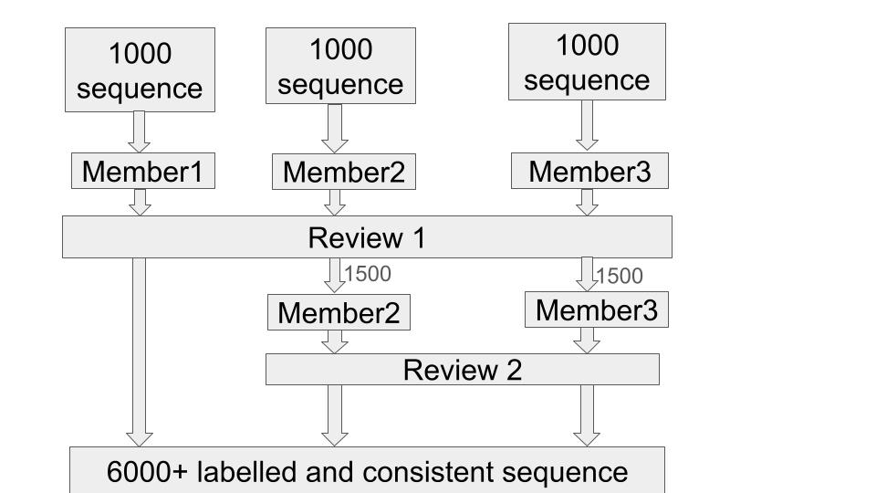
Labelling process Flow

Slide 10
Maintaining Consistency
Reviewing:-
To maintain the consistency it is important to ensure that throughout the labeling process approach of labeling should be same. So in the initial stage it is need to be decided which group member will continue the process of labelling.
Ambiguity:-
It is possible that the way sequence is wrote can confuse from which class it belongs.
Example:-
Congress is turning anti ***** on the name of secularism.
****** should unite and charge while retaining iniquities of caste.

Slide 11
Challenges
Threshold for class separation:-
Without knowing the full data which is going to be labelled it is not possible to know all the threshold on the basis of which sequences it is going to be labelled.
Keeping the prelabeled data useful:-
As new sequences are encountered new basis for the class separation are added but it is important to focus on prior basis as well

Slide 12
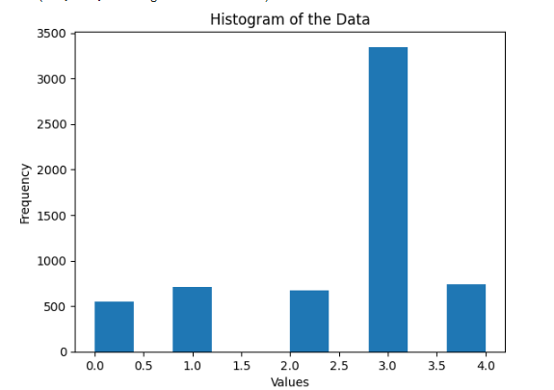
Conclusion
After overall data collection process we have 6019 labelled sequences
The distribution of sequences in the class is following

Slide 13
Not Relevant : 3346
International Affairs : 736
Radical Violence : 714
Non Radical Violence : 675
Extremism : 548
Data Link: data in excel
After all labelling process we get to learn that what will be overall flow and key points to remember when starting the data collection.

Slide 14
Thank you

